Slide 1
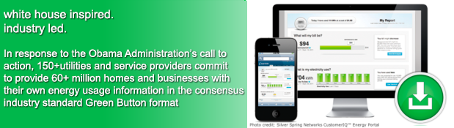



General Services Administration
Green Button Pilot
Mark Ewing, Director, GSA Energy Division, mark.ewing@gsa.gov
John Teeter, Computer Scientist, NIST, john.teeter@nist.gov
Presidential Innovation Fellow Alumni

Slide 2
GSA Pilot of Connect My Data
GSA Pilot: Goals and Achievements
Detailed Green Button Discussion
Overview of the Moving Parts

Slide 3


Use Case: The Energy Audit
Site visit
Long lead time
Slow feedback
Very Thorough
Analysis and Discovery
Benchmarking
Opportunity Identification
Projections
Hands
On
Audit
No site visit
Short Lead Time
Rapid Feedback
Less Thorough
Facilities Operation
Management
Benchmarking
…
Virtual
Audit
Buildings
Occupancy Models
Sub-Meter 1
Sub-Meter 2
…

Slide 4


Framing the Energy Management Discussion
Contracted Service Provider
Analytics
Virtual Energy Audits
…
Utility
MDM
Portal
Agency/Owner
Management
Benchmarking
…
Utility
Meter
Building
Energy Management System (EMS)
Sub-Meter 1
Sub-Meter 2
…
Energy Manager
Notes:
Brian overlay – clean up arrows

Slide 5
GSA Pilot Overview
Leverage existing Energy Management Pilot to include agency owned energy management systems via Green Button Connect My Data.
Coordinate with local utility Green Button Connect My Data deployments to receive data obtained from utility owned meters.
Authorize third party to receive Green Button Connect My Data streams from utility and agency owned systems for 5 target buildings in GSA Region 11.
Coordinate with EPA as they determine Green Button integration possibilities for Portfolio Manager.
Provide input to FEMP to aid in the preparation of guidance to be provided to the agencies.
Notes:
Note: Insure to clarify the difference from Facility and Utility data (using GSA terms of

Slide 6
GSA Pilot In Facility Management
Encourage vendors to support Green Button standard when providing energy-related services to GSA
Details:
Request Schneider-Energy EEM product team to provide Green Button Connect My Data to transmit submetering interval data to Energy Services Vendor (First Fuel)
Request First Fuel to Provide Green Button data in monthly format to EPA Portfolio Manager using Green Button Connect My Data
Desired Outcome:
Prove benefits of interoperable access to Green Button data for GSA Energy Efficiency Processes
Increase ability of businesses and other agencies to participate in energy efficiency programs using Green Button

Slide 7
Engage Utilities (Pepco Holdings)
Ask utilities to provide GSA electricity data in Green Button format
Details:
GSA usage utilities that serve its buildings
GSA asks utilities to use “Connect My Data” standard to link data directly to energy management/efficiency systems and vendors (First Energy)
Desired Outcome:
Prove Utility Interval Data Supports GSA Efficiency Programs
Integrate Utility Data with (Interoperable) Green Button Data from Building Sub-Meter systems

Slide 8
Future Goal: Publish GSA’s Utility Data
Publish GSA facilities utility data (ideally in the Green Button format)
Details:
Send Green Button data to EPA/Portfolio Manager using Green Button Connect My Data
DOE’s Building Performance Database is seeking data
data.gov to support public consumption of energy efficiency information
Desired Outcome:
Significantly increase the volume of publically available building and utility data available to researchers, developers and the public
Increase effectiveness of energy benchmarking tools by providing a significant increase in data availability
Notes:
Opportunity for Public Engagement

Slide 9
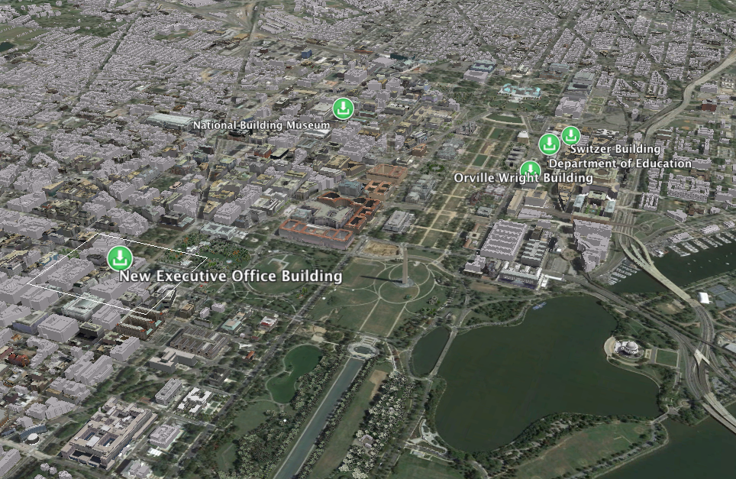
GSA Building Selections
New Executive Office Building
Orville Wright Building
National Building Museum
Department of Education
Switzer Building
Notes:
Adjust

Slide 10
Section 3.B.i - GSA Pilot Activities
OSTP/CEQ/GSA/NIST/DoE Pilot Plan
PEPCO Connect My Data Pilot
DC Pilot Operational
7/2013
4/2014
Technical Discussions
1/2013 – 2/2013
8/2013 – 10/2013
EPA Technical
Discussions
2/2014
EPA Portfolio
Manager Plan
Vendor Identification
11/2013
GSA Pilot Strategy
Prepared/Initiated
TBD
DC Pilot Plan
FirstFuel/
PEPCO/Schneider
2/2014
12/2013
3Q 2013
4Q 2013
2Q 2014
1Q 2014
Climate Action Plan
June 2013
Presidential Memo
Dec 2013
FEMP Guidance Initiated Apr 2014
Notes:
cleanup

Slide 11
Pilot Status
Utility Green Button data flowing to First Fuel
Green Button Certification for Schneider-Electric Energy Profiler Online (EPO) product
Schneider-Electric EEM product aggregating in facility data
Automated movement of data from both sources to First Fuel on a daily basis
Benchmarking by First Fuel
Pilot Summary and Lesson Learned to be finalized and delivered to FEMP
Notes:
Check timing of last bullet

Slide 12
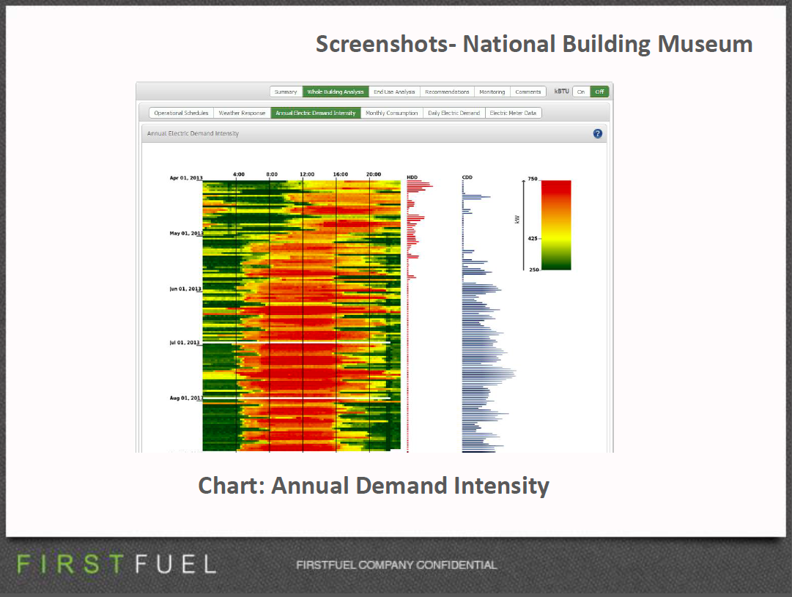
Analytics for Active Management
Notes:
Fix sizes

Slide 13
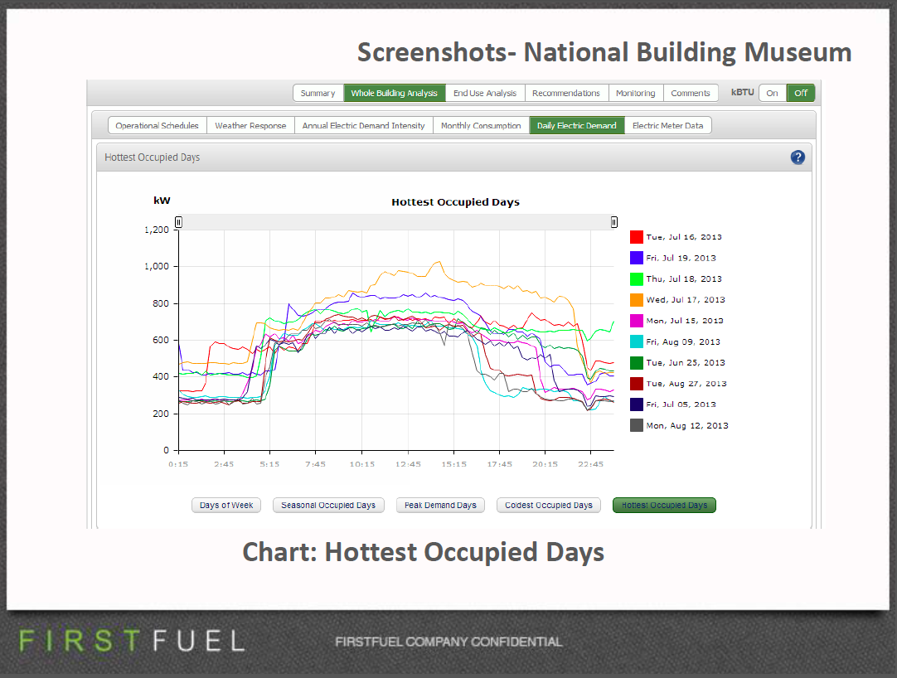
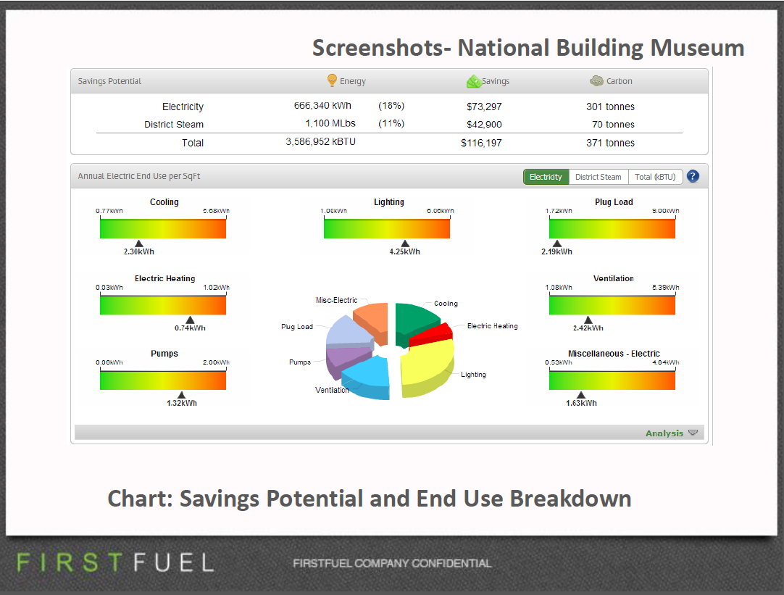
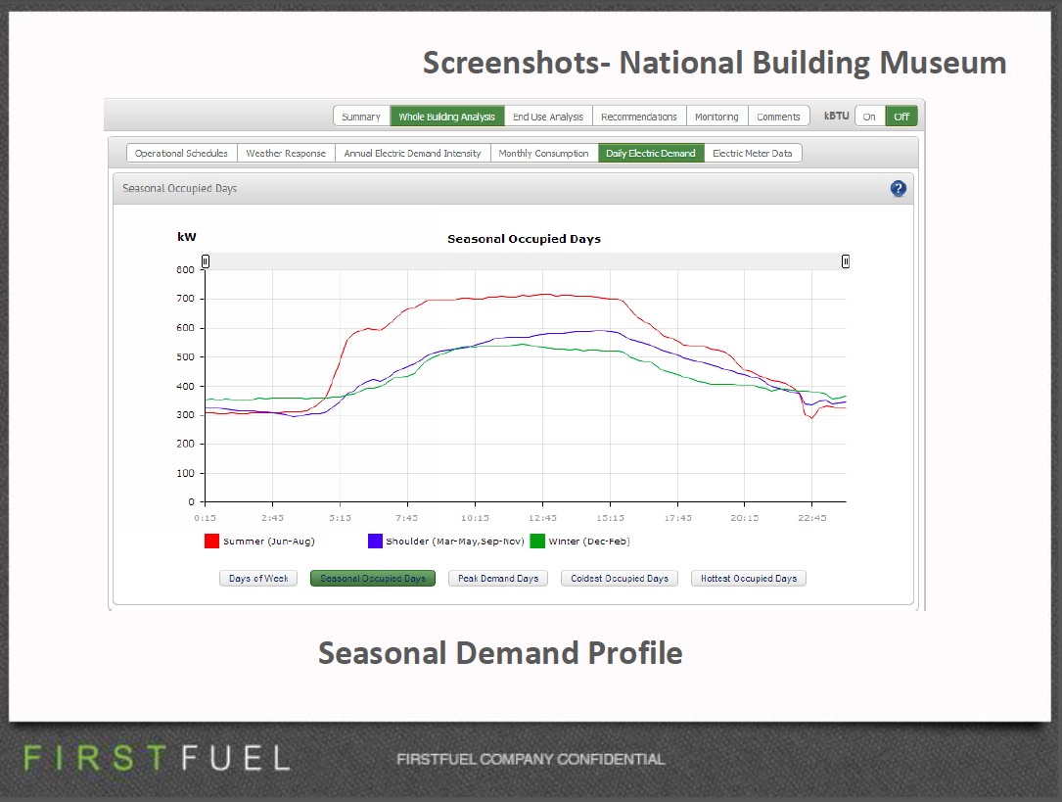
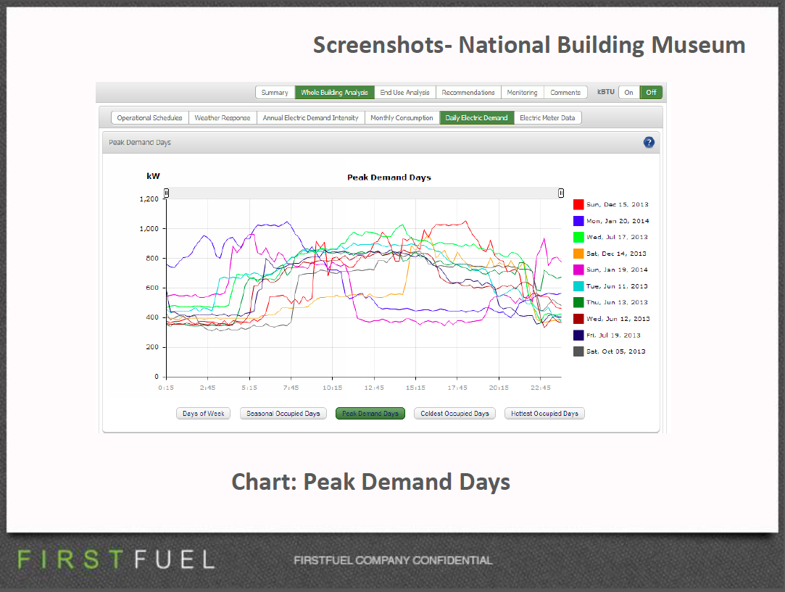
Analytics for Active Management

Slide 14
Agenda
What is Green Button? ⬅⬅
Brief history of the initiative, goals, current status
How might Green Button support MLS?
Thoughts and Explorations
Background
Recent GSA Pilot of Connect My Data
GSA Pilot: Goals and Achievements
Detailed Green Button Discussion
Overview of the Moving Parts

Slide 15
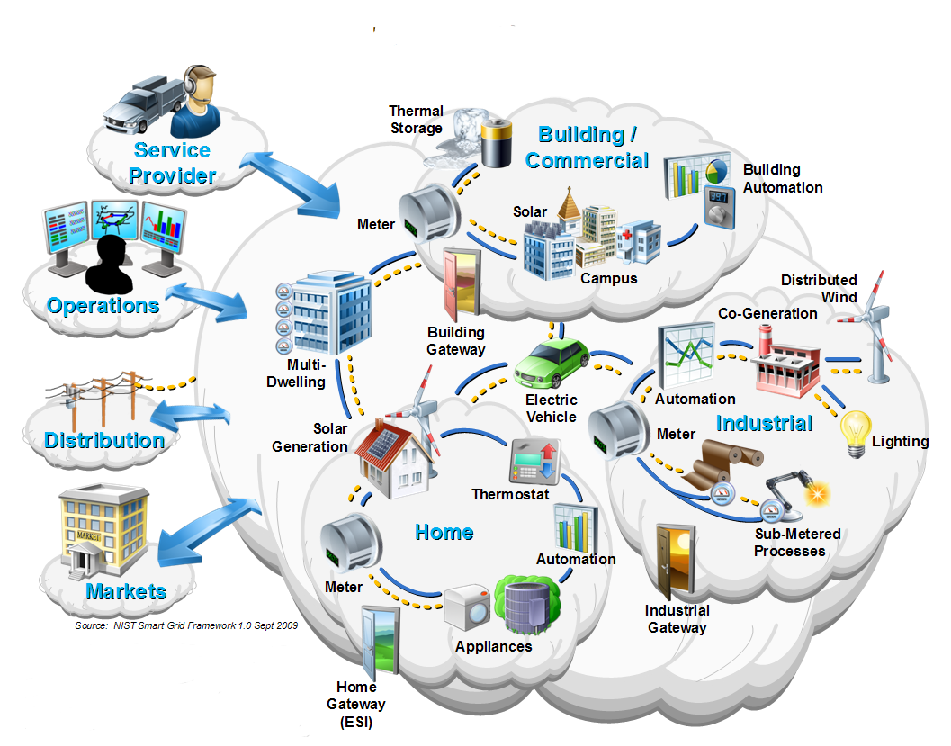
Smart Grid Consumer Domain

Slide 16
Green Button Privacy and Security
Data Security.
Standard Certificate Based HTTPS and SFTP
Uses IETF OAuth2 authorization
Requires 128 bit (Third Party) and 256 bit (Data Custodian) Transport Layer Security
Aligned with NIST best practices
Personal Identifiable Information (PII)
Certified Green Button Metered Data contains no PII
All Location information must be exchanged separately from Metered Data
Account and Portfolio information must be exchanged separately from Metered Data
DOE is leading a Voluntary Code of Conduct Stakeholder Process

Slide 17
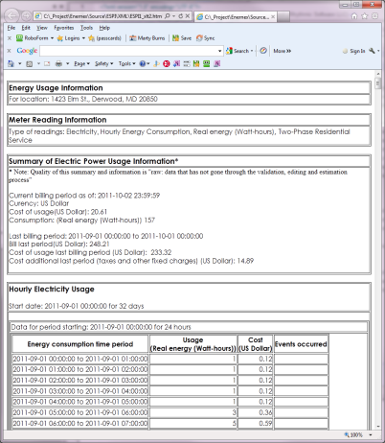
Both Utility and Facility Data
Measurements of power, energy, gas, water, …
Quality: Raw, validated, estimated, …
Source: Meter near real-time, utility back end, third party
Economics: Consumers need to know the cost of their consumed power (but we did not construct a pricing model)
Identification: by customer, device, location
Interval data
Summary Information
Power Quality Metrics
Utility
Data
Facility
Data

Slide 18


Green Button Data Exchange
Data Custodian
Third Party
Third Party Registration
Web Service Provider
Web Service Consumer
Automated Transfer
Web Portal
One-time Authorization
Web Portal
Retail Customer
User (agent)

Slide 19

Simple Agency Energy Manager
Rural Co-op
Agency Energy Repository
Agency Registration
Web Service
Web Client
Automated Transfer
Web Portal
One-time Authorization
Web Portal
Utility Meter
Agency Energy Manager
User (agent)

Slide 20
GSA Pilot Scenario Five Buildings
Building 5 EMS
Building 4 EMS
Building 3 EMS
Web Service
Building 2 EMS
Web Service
Building 1 EMS
Web Service
First Fuel
Web Portal
Web Service
Pepco Holdings
Web Portal
Web Service
Web Client
Automated Transfer
Web Service
Web Portal
Web Portal
Web Portal
One-time Authorization
Web Portal
Web Portal
New Executive Office Building
Department of Education
Orville Wright (FOB10A)
Switzer FB
National Building
GSA Energy Manager
User (agent)

Slide 21
General Federal Support
Utility or
Energy Management System
Agency or
Contracted Third Party
Agency Registration
Web Service
Web Client
Automated Transfer
Web Portal
One-time Authorization
Web Portal
Agency Energy Manager
User (agent)

Slide 22
Value Propositions
Cost Effective Improvements to Advanced Metering Infrastructure
Utility did not charge additional fees for Green Button capabilities
Offsets GSA’s capital expenditure to install additional metering where utility interval data is available
Offsets O&M costs associated with maintaining meters
Compatible with agency metering systems
Green Button can lower the cost of deployment for agency energy management

Slide 23
Value Propositions
Data Quality/Data Validation/Data Scaling
12% of GSA metering infrastructure is missing data due to meters being offline. Green Button Data gives GSA the opportunity to replace this missing data with utility interval data from second (utility) source.
Green Button Data can also be used to correct data anomalies in Energy Management Systems such as spikes, blanks, null values etc.
Green Button encourages multiple vendors to present data to GSA in a uniform, interoperable manner.

Slide 24
Lessons Learned
Significant value achieved through active management
Virtual energy audit for all properties is possible
Data drives efficient management
Interoperability is KEY
Look for Certified Connect My Data implementations in 2015
Leverage your purchasing power to bring your service providers on-board!
Early in the Green Button Connect My Data life cycle
Pepco/Schneider first in the nation commercial deployment
National Rollout 2015-2016 – plan for success now!

Slide 25
What is Green Button? – How is it useful to Federal Agencies?
Green Button is a standard for data exchange inspired by the federal government and enabled by the private sector
The Green Button carries the metered data that enables active management of resource usage
Green Button provides a uniform way for energy managers to use metered data across multiple utilities to manage large portfolios
Agencies can save on their energy costs
Agencies can provide uniform data to Portfolio Manager
Agencies can leverage real, measured data to monitor and manage their energy and resource usage
Notes:
Fix spacing – line visual

Slide 26
FAQ Development
How do I find out if my utility supports Green Button Connect My Data?
Is a Smart (AMI) meter required for Green Button Support?
How do I determine when in Facility Metering is justified?
Is there a roadmap for agency support of Green Button in their energy management processes?
Are agencies to be provided information as to vendors whose products and services support Green Button?
Do agencies have a sense as to how many of their facilities are in services areas of utilities that support Green Button?
What authority do agency managers have to initiate Green Button energy management activities?
How are larger facilities such as campuses or bases to approach the Green Button opportunity
http://www.greenbuttondata.org/fed-faq/

Slide 27

Thank You

